Slide 1







Contents
BNMIT College Chat Bot: Enhancing Access and Engagement
1. Introduction. 2. Problem statement 3. Objectives 4. Methodology 5. Results 6. Conclusion 7. References
Shriparna 1BG22EC100 Vivek R D 1BG22EC121 Rahul 1BG22EC080

Slide 2


BNMIT College Chat Bot:
Enhancing Access and Engagement
Contents
1. Introduction. 2. Problem statement 3. Objectives 4. Methodology 5. Results 6. Conclusion 7. References
BNMIT College Chat Bot project,that aims to enhance communication and accessibility for everyone.
Our project involves the development of a chatbot, a conversational agent, tailored to assist students,and visitors in navigating through the information about college.
Through the BNMIT College Chat Bot, we aspire to provide a seamless and user-friendly interface for accessing information, addressing queries, and good engagement.

Slide 3


Problem Statement
BNMIT College Chat Bot:
Enhancing Access and Engagement
Addressing Communication Challenges with a Virtual Assistant
In any educational institution, effective communication is key to providing Visitors, Students and Staff with timely information and support.
However, traditional methods of communication, such as emails and notices, can often be overwhelming, easily missed, or not readily accessible when needed.
Our project tackles this challenge by introducing a virtual assistant, or chat bot, specifically tailored for BNMIT College. The problem we're addressing is the need for a more interactive and efficient way to disseminate information, answer queries, and assist individuals across various aspects of college life.
BNMIT College Chat Bot project,that aims to enhance communication and accessibility for everyone.
Our project involves the development of a chatbot, a conversational agent, tailored to assist students,and visitors in navigating through the information about college.
Through the BNMIT College Chat Bot, we aspire to provide a seamless and user-friendly interface for accessing information, addressing queries, and good engagement.

Slide 4



Objectives
Problem Statement
Addressing Communication Challenges with a Virtual Assistant
In any educational institution, effective communication is key to providing Visitors, Students and Staff with timely information and support.
However, traditional methods of communication, such as emails and notices, can often be overwhelming, easily missed, or not readily accessible when needed.
Our project tackles this challenge by introducing a virtual assistant, or chat bot, specifically tailored for BNMIT College. The problem we're addressing is the need for a more interactive and efficient way to disseminate information, answer queries, and assist individuals across various aspects of college life.
To make the Visitors, Students and Staff to easily access the information.
Enable users to submit admission details conveniently.
Improve user engagement and experience through interactive assistance.

Slide 5



c
Methodology
Objectives
To make the Visitors, Students and Staff to easily access the information.
Enable users to submit admission details conveniently.
Improve user engagement and experience through interactive assistance.
Programming Language: We chose C as our programming language due to its robustness and low-level capabilities, making it suitable for system-level applications.
Data Structures: We employed structs, user-defined data types, to encapsulate related information like admission details and user issues.
Modular Design: The code follows a modular approach, with separate functions for different tasks such as displaying information, handling admission forms, and recording issues.
User Interaction: The user interacts with the chat bot through a command-line interface, providing a straightforward means of communication.

Slide 6
c
Methodology
Programming Language: We chose C as our programming language due to its robustness and low-level capabilities, making it suitable for system-level applications.
Data Structures: We employed structs, user-defined data types, to encapsulate related information like admission details and user issues.
Modular Design: The code follows a modular approach, with separate functions for different tasks such as displaying information, handling admission forms, and recording issues.
User Interaction: The user interacts with the chat bot through a command-line interface, providing a straightforward means of communication.

Slide 7
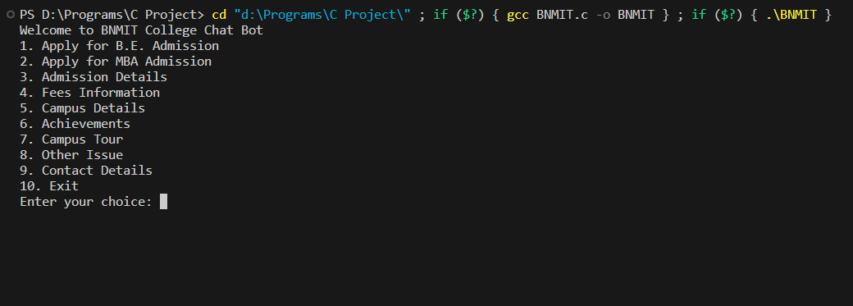
c
Methodology
File Handling: We utilized file handling to store admission details and user issues in separate files, ensuring organized data management.
Color-Coded Output: ANSI color codes were used to enhance the user experience by providing colorful and visually appealing text-based output.
Feedback Loop: The chat bot prompts users for further questions, offering a smooth and interactive conversation flow.

Slide 8
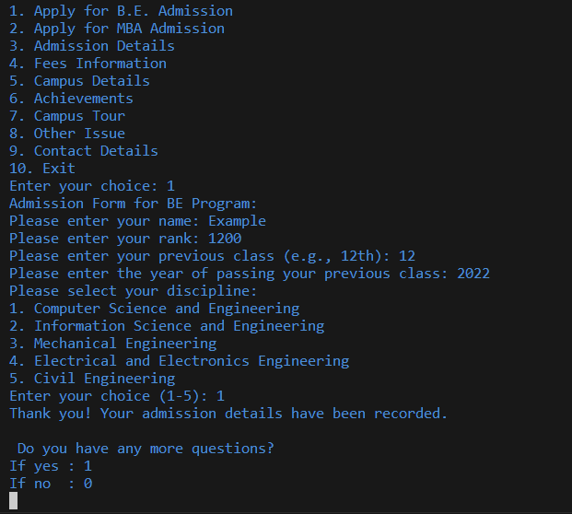
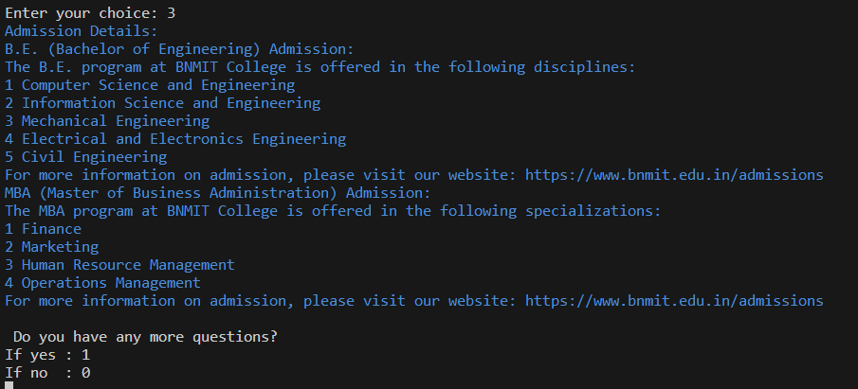
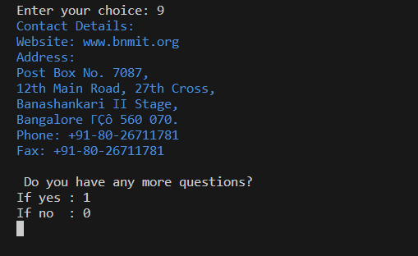
Conclusion
Results:
BNMIT College Chat Bot successfully addresses the challenge of providing comprehensive information to prospective students.
The project's user-friendly interface makes it accessible to a wide range of users, including those with limited technical expertise.
Through structured methodologies and data storage techniques, the chat bot efficiently manages user inquiries and admission details.
The chat bot's ability to provide real-time information contributes to a smoother admission process for both students and administrators.
The project showcases the practical application of programming and data structures in solving real-world problems.
BNMIT College Chat Bot aligns with the institution's commitment to leveraging technology for enhanced educational experiences.
Successful creation of the BNMIT College Chat Bot
Seamless communication with users through a user-friendly command-line interface
Efficient handling of admission inquiries, providing program details, fees information, campus details, and more
c

Slide 9
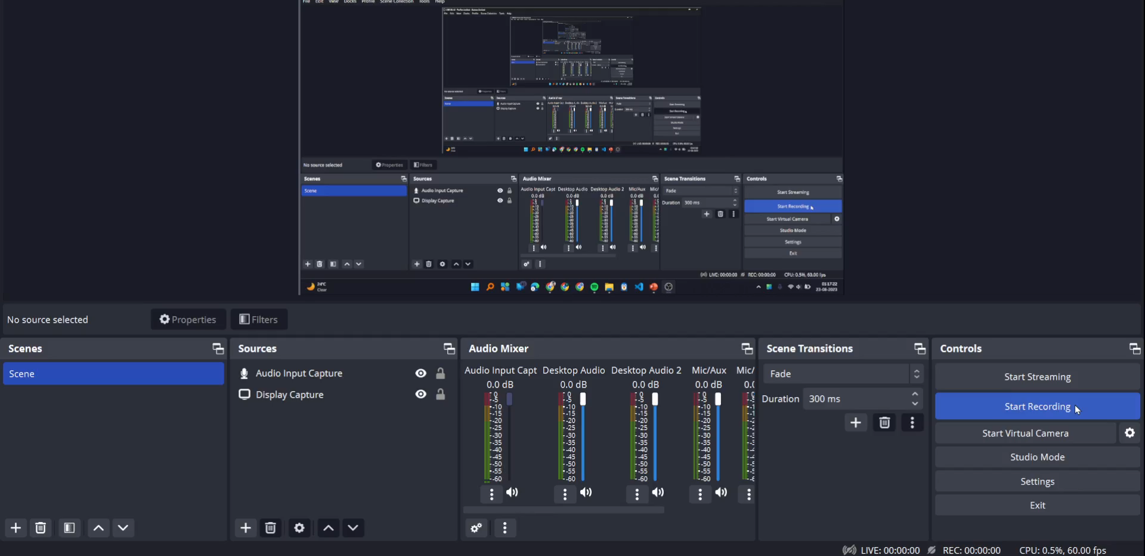
Results:
https://rahulbomnalli7.github.io/bnmit/ //Demo College Website using HTML and CSS Languages
c

Slide 10
Conclusion
Results:
BNMIT College Chat Bot successfully addresses the challenge of providing comprehensive information to prospective students.
The project's user-friendly interface makes it accessible to a wide range of users, including those with limited technical expertise.
Through structured methodologies and data storage techniques, the chat bot efficiently manages user inquiries and admission details.
The chat bot's ability to provide real-time information contributes to a smoother admission process for both students and administrators.
The project showcases the practical application of programming and data structures in solving real-world problems.
BNMIT College Chat Bot aligns with the institution's commitment to leveraging technology for enhanced educational experiences.
https://rahulbomnalli7.github.io/bnmit/ //Demo College Website using HTML and CSS Languages
c

Slide 11



C Documentation
Website
www.bnmit.org
Conclusion
References
BNMIT College Chat Bot successfully addresses the challenge of providing comprehensive information to prospective students.
The project's user-friendly interface makes it accessible to a wide range of users, including those with limited technical expertise.
Through structured methodologies and data storage techniques, the chat bot efficiently manages user inquiries and admission details.
The chat bot's ability to provide real-time information contributes to a smoother admission process for both students and administrators.
The project showcases the practical application of programming and data structures in solving real-world problems.
BNMIT College Chat Bot aligns with the institution's commitment to leveraging technology for enhanced educational experiences.
Notes
YouTube tutorials
Anirudh Khanna;Mansee Jain;Tanesh Kumar;Deepa Singh;Bishwajeet Pandey;Vikas Jha2015 International Conference on Computational Intelligence and Communication Networks (CICN) [1]
C. Kavitha;K. Pavun Kavitha2023 Eighth International Conference on Science Technology Engineering and Mathematics (ICONSTEM) [2]

Slide 12
References
Website
www.bnmit.org
C Documentation
YouTube tutorials
Notes
Thank You!
Anirudh Khanna;Mansee Jain;Tanesh Kumar;Deepa Singh;Bishwajeet Pandey;Vikas Jha2015 International Conference on Computational Intelligence and Communication Networks (CICN) [1]
C. Kavitha;K. Pavun Kavitha2023 Eighth International Conference on Science Technology Engineering and Mathematics (ICONSTEM) [2]

Slide 13
Thank You!

